Slide 1



Ontology-based Subgraph Querying
Yinghui Wu Shengqi Yang Xifeng Yan
University of California, Santa Barbara

Slide 2
Outline
Searching graphs with semantic similarity
  Graph searching with label equality is an overkill
  Capturing semantically related matches
Ontology-based subgraph search
  Ontology graphs, ontology-based subgraph search framework
  Using ontology graphs to capture semantically related matches
Ontology-based Querying Framework
  Ontology-indexing
  Filtering-and-verification
Incremental maintenance
Conclusion
Subgraph querying using ontology information

Slide 3







Motivation: travel planning
Q: “find tourists who recommend a museum with guide service, and also favor a restaurant 'riverside' close to the museum.”
museum
Royal gallery
...
Q
G
not match!
recom
recom
near
guide
near
guide
like
like
tourists
‘riverside’
‘cultural tour’
‘waterfront’
Traditional subgraph isomorphism can be too restrictive
Notes:
To ask correct question would be difficult when users don’t know scheme or details of data graphs;
How can we still find answer even when an “inaccurate” query is issued?

Slide 4



Motivation: travel planning
Q: “find tourists who recommend a museum with
guide service, and favor restaurant ' riverside' close to the museum.”
A:“We found 'cultural tour' group who recommend royal gallery with guide. They like a nearby restaurant 'waterfront' which used to be 'riverside’.”
museum
Royal gallery
Q
not match!
recom
G’
guide
recom
guide
near
match!
near
tourists
‘riverside’
‘cultural tour’
‘waterfront’
Og
include
Is a
renamed
Royal gallery
...
tourists
‘cultural tour’
museum
‘riverside’
‘waterfront’
Using ontology-information to capture semantically similar matches

Slide 5
Queries, data graphs and ontology graphs
Data graph G (V,E,L) and query graph Q(V_{q}, E_{q}, L_{q})
Ontology graph O (V_{r}, E_{r}): an undirected graph where V_{r} refers to a set of entities with labels, and E_{r} is a set of edges among the labels, denoting semantic relations (e.g., “refer to”, “is a”, “specialization”, etc)
A similarity function sim(v_{r1} , v_{r2}) computes the similarity of two nodes in O, which is a monotonically decreasing function of the distance between v_{r1} and v_{r2}.
Example of ontology graphs:
  Taxonomy ontology: biological taxonomies
  Knowledge graphs: Yago, DBpedia, Freebase, Google knowledge graph …
  Ontology chart, semantic Web…
A travel ontology
attraction
guided tours
museum
park
Holiday
tour (HT)
Culture
tour (CT)
includes
Royal Gallery (RG)
tourists
Disneyland
Sim(v₁,v₂) = 0.9 ^{d(v1, v2)}
Sim(museum, Disneyland) = 0.81 Sim(museum, RG) = 0.9
Restaurants
Leisure center
‘waterfront’
equivalent
Holiday Cafe
Holiday
Plazza (HP)
‘riverside’
Royal
Place (RP)

Slide 6










Why ontology-based search?
Q: “find suspect A using class I guns in a safehouse”
A:“we found a match [who report to A] using class II guns [a type of class I guns] in a [relocated] safehouse”
Q
safehouse
not match!
...
G
match!
rifle
relocate to
...
...
supervise
subclass
report to
Og
Using ontology-information to capture semantically similar matches

Slide 7
Ontology-based subgraph querying
Ontology-based subgraph querying: given a data graph G, a query graph Q and an ontology graph Og, identify K best matches Q(G) based on semantic closeness.
semantic closeness C(h) for a mapping h:
C(h)=Σ sim(L_{q}(u), L(h(u))), u∈V_{q}
u
C(h)=0.9+0.9 = 1.8
h(u)
L(h(u))
Objective: identify matches with minimum semantic closeness
Lq(u)
v
h(v)
Lq(v)
Q
Og
L(h(v))
G

Slide 8

Querying framework
A filtering-and-verification querying framework
  (1) offline ontology indexing: construct “concept graphs” of G as an ontology index, by summarizing G using Og
  (2) online ontology-based filtering-and-verification
A query evaluation framework (comparing with query enumeration):
index construction in (O(|G|log|G|) time)
filtering in O(|Q||I| time)
Og
ontology index
query view
Q
G
Q₁
Q₂
Q
Q₄
Q₃
verification
Q₅
equivalence!
…
Q(G)
Q(G)

Slide 9
Ontology-based indexing
A concept graph G_{o}(V_{o},E_{o},L_{o}) is a directed graph:
  nodes V_{o} represents a node partition of G; each partition v_{o} has a concept label L_{o} (v_{o}) from ontology graph Og; each node in v_{o} has its original label close to L_{o} (v_{o})
  two partitions v_{o1} and v_{o2} are connected iff each node in v_{o1} (resp. v_{o2}) has a neighbor in v_{o2} (resp. v_{o1}) via a same type of connection
Ontology index: a set of concept graphs of G
Edge grouped by connections from two groups of nodes referring to two concepts
Node grouped by a same ontology label as a concept
pink
rose
flame
red
red
yellow
rose
flame
blue
sky
violet
pink
red
blue
blue
blue
green
green
lime
olive
sky
violet
lime
olive
green
green

Slide 10
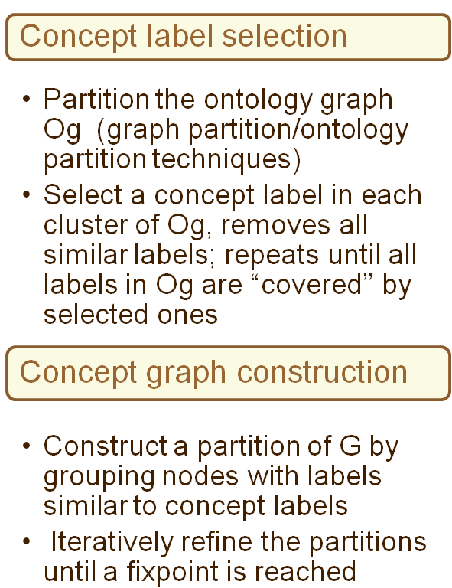
An algorithm to construct ontology index
yellow
rose
flame
pink
rose
flame
pink
rose
flame
pink
red
blue
sky
violet
blue
sky
violet
blue
green
sky
violet
lime
olive
green
lime
olive
green
lime
olive
pink
rose
flame
rose
flame
yellow
red
red
blue
pink
red
blue
blue
sky
violet
blue
green
green
green
sky
green
lime
olive
violet
lime
olive

Slide 11
Ontology-based “views”
pink
rose
flame
rose
flame
yellow
pink
red
blue
sky
violet
blue
green
green
lime
olive
sky
violet
lime
olive
data graph
ontology of color
red
Node grouped by a same ontology label as a concept
red
Edge grouped by connections from two groups of nodes referring to two concepts
blue
blue
ontology view:
a concept graph
green
green
Viewing data graph from the perspective of ontology groups

Slide 12
Ontology-based Subgraph Matching
Offline index construction
  Select concept labels and construct label partition for Og
  Group data nodes in G according to grouped labels in Og
  Filtering and refinement to construct a concept graph Gc
Online query processing (top-K matches)
  Matching: select candidates for each query node in Q (using a lazy strategy); compute a matching relation M from Q to each concept graph Gc;
  Subgraph extraction: compute intersection of the matches M from Q to each Gc; return the induced subgraph Gv
  Verification: extract top-K matches from Gv
O(|E| log |V|)
O(|Q| |I|)
O(|Q| |I|)+ |Gv|^{|Q|}
Filtering-and-verification process based on ontology index

Slide 13
Ontology-based Subgraph Matching
Offline index construction
Online query processing (top-K matches)
  Matching: select candidates for each query node in Q (using a lazy strategy); compute a matching relation M from Q to each concept graph Gc;
  Subgraph extraction: compute intersection of the matches M from Q to each Gc; return the induced subgraph Gv
  Verification: extract top-K matches from Gv
O(|E| log |V|)
O(|Q| |I|)
O(|Q| |I|)
O(|Q| |I|)+ |Gv|^{|Q|}
Filtering-and-verification process based on ontology index

Slide 14



Matching algorithm: example
Q
museum
Disneyland
Holiday Cafe
‘waterfront’
Royal Gallery (RG)
recom
guide
G
Using ontology index to generate view graphs from Q to concept graphs
tourists
riverside
Holiday
Plaza (HP)
Holiday tour (HT)
Royal Place (RP)
Culture tour (CT)
Ontology Index I
tourists
museum
park
park
park
tourists
museum
HT
Disneyland
HT
Disneyland
RG
CT
HT
Disneyland
RG
CT
CT
RG
CT
RG
HP
HC
HC
Verification by extracting matches from the view graph
waterfront
RP
HP
RP
RP
waterfront
waterfront
HC
waterfront
moonlight
Leisure center
riverside
riverside
Leisure center
riverside
tourists
museum
Royal gallery
HT
Disneyland
Gv
recom
park
CT
RG
park
guide
HC
waterfront
RP
‘cultural tour’
moonlight
riverside
‘waterfront’

Slide 15
Matching algorithm: example
pink
red
red
Q
blue
blue
blue
concept
graph
lime
olive
lime
green
green
flame
Q(G)
red
violet
Filtered
“view”
graph
blue
green
green
lime
olive
green
Filtering and verification over ontology index

Slide 16
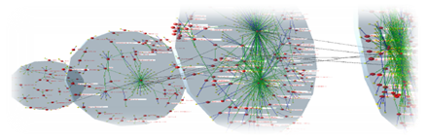
Dealing with dynamic world
Real-life graphs are changing all the time…
Dynamically update ontology index
  Given update ∆G to data graph G, compute corresponding changes to the ontology index ∆I
Affected area: the total changes in the input ∆G and the ontology index ∆I, i.e., |AFF| = |∆G| + |∆I|
Incremental updating process:
  Identify a set of initially affected nodes and edges in I
  Propagate the changes in concept graphs via BFS traversal
  Perform split-merge operation; update affected area and I
O(|AFF|²+ |I|)
Measuring complexity using affected area

Slide 17
Dealing with dynamic world
Disneyland
Holiday Cafe
‘waterfront’
Royal Gallery (RG)
G
Holiday tour (HT)
Holiday
Plaza (HP)
Royal Place (RP)
Culture tour (CT)
Identify initial AFF
propagate AFF and changes
park
park
park
park
park
park
HT
Disneyland
RG
CT
HT
Disneyland
RG
CT
HT
CT
RG
Disneyland
HP
RP
HP
RP
HP
RP
HC
waterfront
HC
waterfront
HC
waterfront
Leisure center
riverside
Leisure center
riverside
Leisure center
riverside
Directly compute changes to the index instead of recomputing everything
Notes:
The ontologies labeled with leisure center already are connected to each ontology labeled with riverside, and vice versa. Thus, e1 does not change concept graph Go2.

Slide 18
Experimental study
Real-life datasets
  CrossDomain :
    1.07M entities from various domains (Wikipedia, geography, biology, music, news etc)
    3.86M edges (e.g., born in, locate at, favors)
    ontology graph of 1.44M concepts and 5.3M relations
  Flickr, a graph with 1.3M entities (images, tags, users, locations) and 6.42M edges, and an ontology graph from DBpedia with more than 3.64 million entities.
  Synthetic graphs
Algorithms: ontology index construction OntoIdx, matching algorithm Kmatch, an enhanced subgraph isomorphism VF2 with similarity matrix and terminates when K matches are identified
Notes:
CrossDomain, an RDF graph of 1.07M entities from various domains (Wikipedia, geography, biology, music, news etc.) and 3.86M edges (e.g., born in, locate at, favors), as well as an ontology graph of 1.44M concepts and 5.3M relations
Flickr, a graph with 1.3M entities (images, tags, users, locations) and 6.42M edges, and an ontology graph from Dbpedia with more than 3.64 million entities.
Synthetic graphs

Slide 19


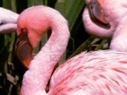
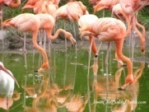
Experimental results: effectiveness
from CrossDomain:
G: 1.07M nodes, 3.86M edges
Og: 1.44M nodes, 5.3M edges
James Cameron
James Cameron
Q₁
Cannes
Festival
“Aliens”
“Ghosts
of the Abyss”
“Aliens of
the Deep”
Walt Disney Pictures
Walt Disney Pictures
Flamingo
from Flickr:
G: 1.3M nodes, 6.42M edges
Og: 3.64M entities (DBPedia)
Flamingo
Q₂
Picture
Picture
Miami
San Diego
Pink
San Diego
Pink
Seaworld Florida
Ontology matching identifies much more meaningful “hidden” matches

Slide 20
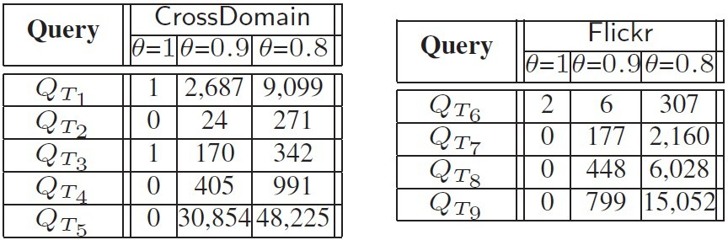
Experimental results: effectiveness
Label equality
Ontology matching identifies much more meaningful “hidden” matches

Slide 21
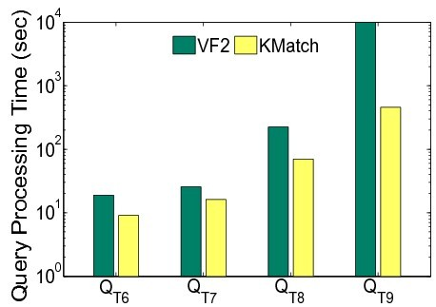
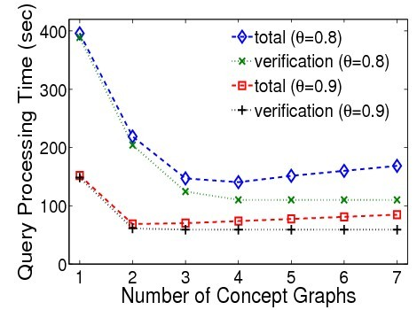
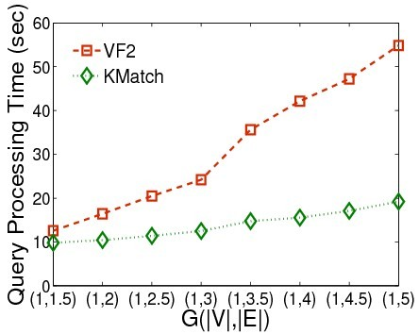
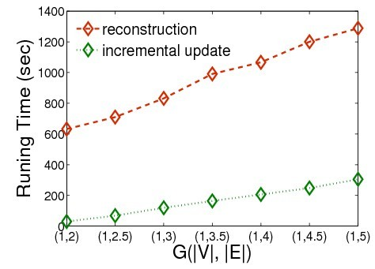
Experimental results: efficiency
30% of the running time of traditional subgraph querying algorithm, e.g., VF2
Effective even with a single concept graph
Ontology index can be efficiently updated upon changes to data graphs
Scale well with data size
Ontology matching outperforms traditional graph querying in efficiency
Notes:
within 15 seconds for graphs with
size 6 million and 2000 labels, and for queries of size 16

Slide 22
Conclusion
Traditional graph matching is too restrictive to identify “hidden matches” in e.g., relationship searching
Basic idea: using ontology information to identify hidden matches that are semantically close to a query
How to do this?
  Ontology index: a set of concept graphs (ontology view of a data graph) constructed by grouping similar labels specified in an ontology graph
  A filtering-and-verification process over ontology index
Ontology-based graph matching efficiently identifies potential matches, and can be applied in dynamically changing world
Also a good source of future work…
extend the idea for other types of graph queries and semantic closeness measurements, e.g., pattern matching, enhanced keyword searching, etc.
how to construct/suggest/refine ontology-based graph queries?
Inference and reasoning in ontology-based graph querying
…
Ontology-based subgraph matching

Slide 23


resources
All of our software and data will be announced in this link: http://grafia.cs.ucsb.edu/
Ness and Nema: source code
  http://habitus.cs.ucsb.edu/SIGMOD11_Ness.tar.gz
  http://habitus.cs.ucsb.edu/VLDB13_NeMa.tar.gz
Sedge: project homepage (docs, source code and dataset)
  http://grafia.cs.ucsb.edu/sedge/
Ontology-based subgraph matching
  http://grafia.cs.ucsb.edu/ontq
Acknowledgement:
  Information Network Science CTA
  Our group: Xifeng Yan, Shengqi, …
Thank you!

Slide 24
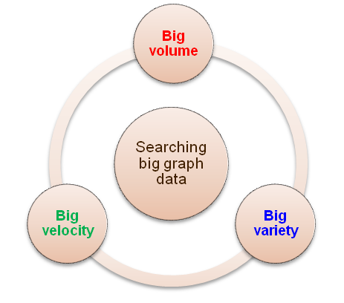
Searching complex graph: a “big graph” issue
computationally efficient query models
partition strategy & management/ distributed querying
compression/summarization
view-based querying
…
semantic searching e.g., ontology-based indexing and querying
usability-expressive power: query suggestion/transformation/rewriting/refinement
knowledge construction and inferencing
…
incremental/dynamic graph querying and maintenance
Spatial-temporal /stream graph querying
…
A great source of research topics and promising search tools

Slide 25
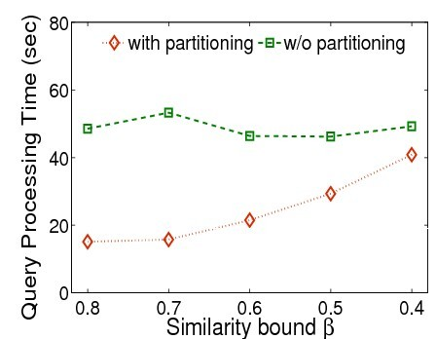
Partitioning strategy
Random selection
Partitioning strategy improves the querying efficiency by up to 70%

